Slide 1


Slide 2
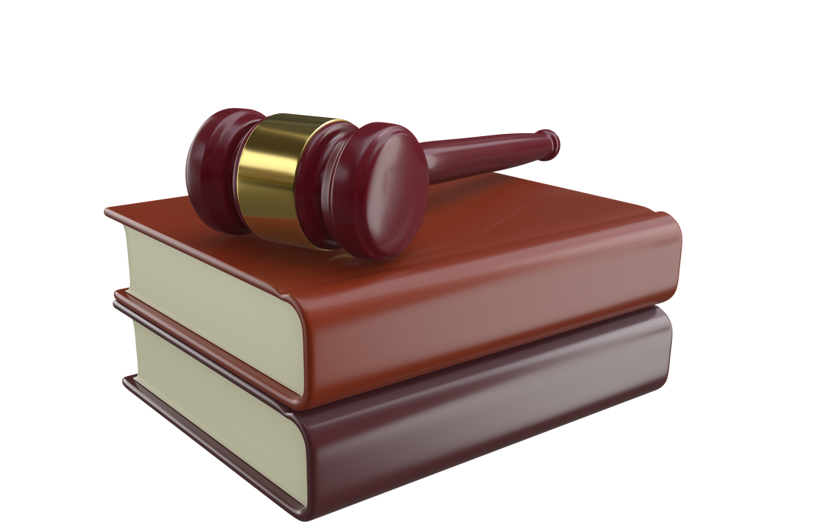

Data availability
Legal documents, deeds, and case records may be hard to collect because it's exist as hard copies.
Language challenges
Constraints and Limitations
Laws exist in Sinhala, Tamil, and English, so accurately translate to English to is difficult.
Technical limits
Small AI models may struggle with very complex cases compared to large models.
Resource limits
Hardware, time, and funding may restrict how much data can be processed or how advanced the system can be.
Legal and ethical issues
Using real legal data must follow privacy, copyright, and government rule
25-26J-240
11/09/2025

Slide 3
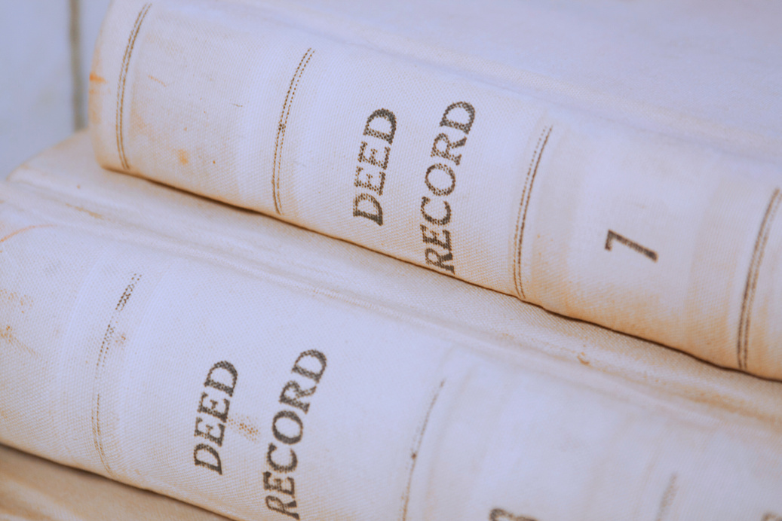

Key Domains of Specialization & Technologies
Key Domains
Warner & Spencer
Business Company
  Agent Creation & Rule-Based Algorithms
  Natural language processing (NLP)
  Document Processing & OCR
  Risk Analysis & Retrieval
Technologies
  Small Language Models (SLMs)
  OCR Engines
  Hybrid Agentic Architecture
  Explainability Tools
  Industry-Grade Frameworks
IT22030412 | A.Thuvaraga | 25-26J-240
08/09/2025

Slide 4
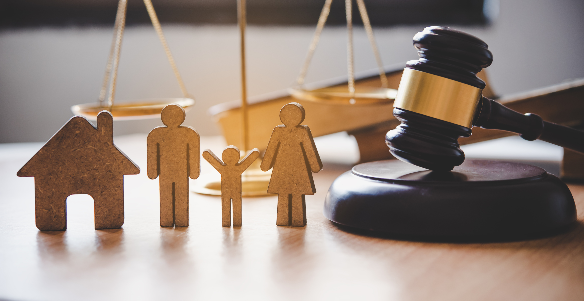

Fine-tuning an SLM to provide end-to-end, step-by-step guidance for resolving user problems in Sri Lankan Property Law and Family Law.
B.Sc. (Hons) Degree in Information Technology Specializing in Information Technology
Mathusigan E.S ( IT22177032 )
IIT22177032 | Mathusigan E.S | 25-26J-240
11/09/2025

Slide 5
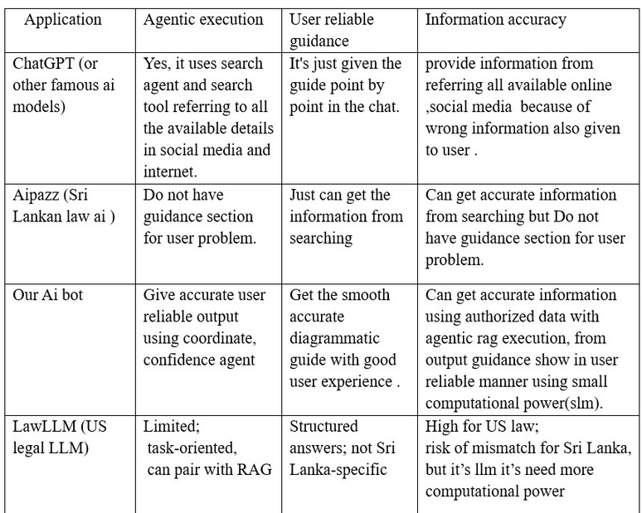
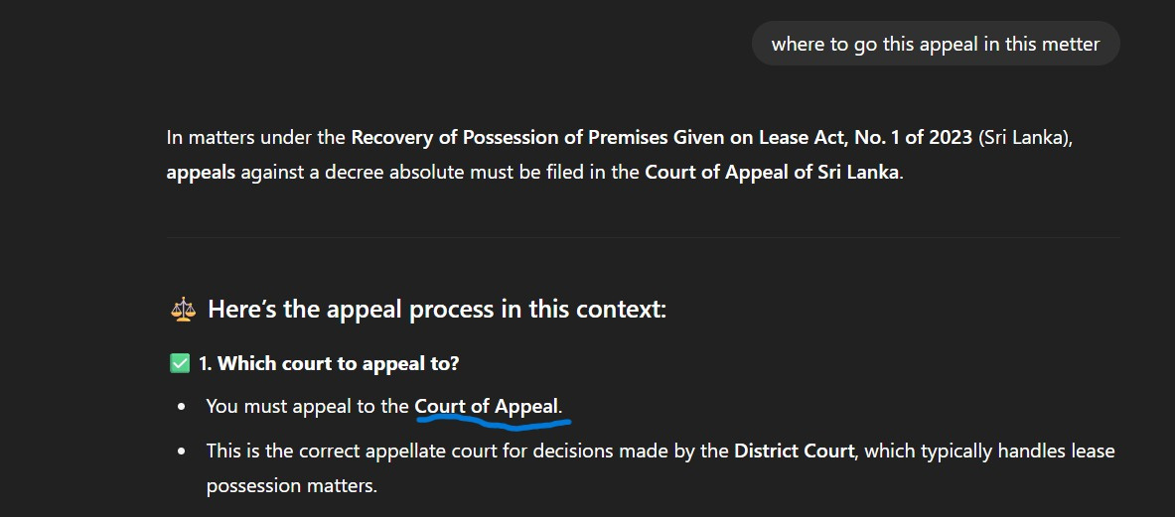
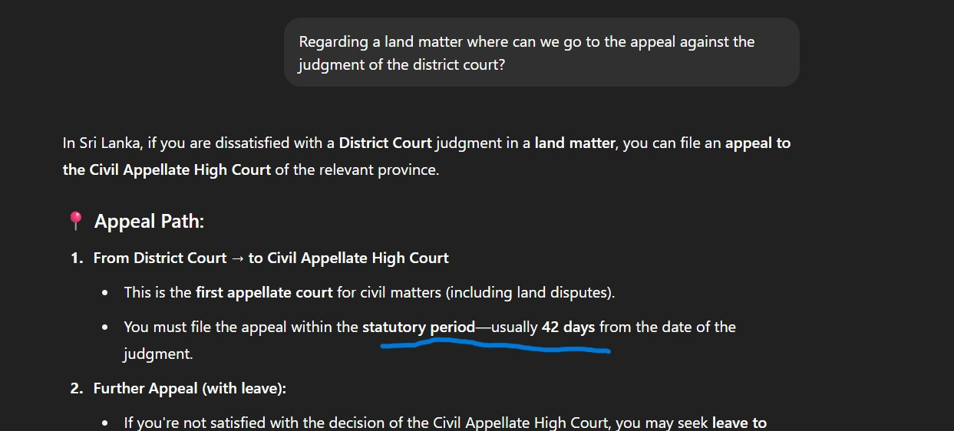
Problem with Current Approaches
IF any Sri Lankan citizens facing issues related to land or family matters usually have to consult a lawyer, which takes time and costs money.
However, today there are already accessible solutions like ChatGPT and Gemini that can provide quick guidance at a lower cost.
IIT22177032 | Mathusigan E.S | 25-26J-240
11/09/2025

Slide 6
Research comparision
Researches | Limitations
Chakrabarti et al. (2019) – AI for Risk in Legal Documents | Relies on general NLP/ML methods (pre-LLM era). No agentic structure, lacks explainable outputs with evidence links. Limited adaptability to scanned/low-quality deeds.
ContractEval (2025) – Benchmarking LLMs for Clause-Level Risk | LLM-heavy → high compute cost, poor fit for low-resource settings. Focused on contracts, not specialized deed types (e.g., Power of Attorney, Gift). Does not integrate rule-based legal checks or OCR handling.
Belcak et al. (2025) – Small Language Models for Agentic AI | Conceptual/theoretical → doesn’t provide domain-specific implementation (like deeds). No evaluation on legal-specific datasets. Still requires integration with domain knowledge (rules) to be useful in practice.
IIT22177032 | Mathusigan E.S | 25-26J-240
11/09/2025

Slide 7
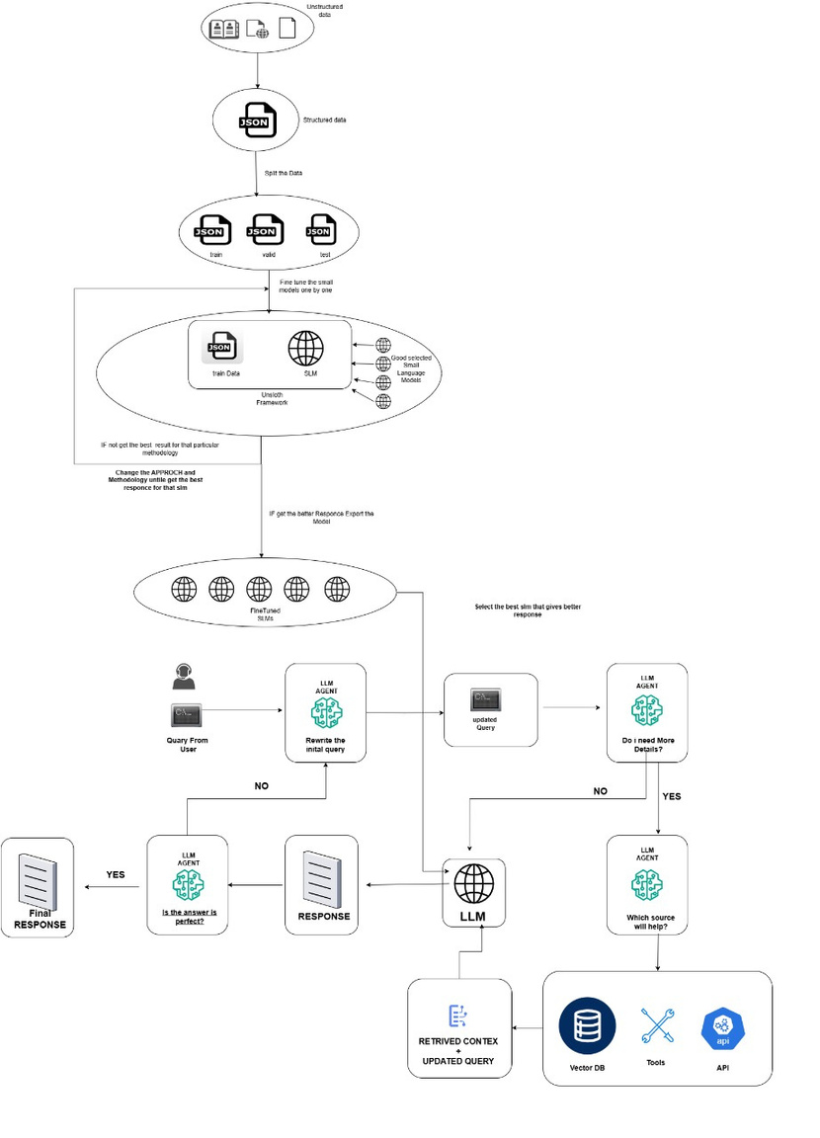
Individual System Daigram overview
User enters legal problem → Chatbot detects Property Law or Family Law → Provides a checklist-style step-by-step guide with citations → User gets clear, structured guidance
IIT22177032 | Mathusigan E.S | 25-26J-240
11/09/2025

Slide 8
Domains of Knowledge
  Natural Language Processing (NLP): Processing legal texts for question-answering, classification, and retrieval.
  Machine Learning (ML): Fine-tuning Small Language Models (SLMs) for legal tasks.
  Data Curation and Annotation: Structuring legal texts into machine-readable datasets with metadata and citations.
Latest Technologies Used
  Small Language Models (SLMs): Lightweight, cost-effective models for domain-specific tasks.
  Unsloth Framework: Tool for efficient SLM fine-tuning with reduced compute needs.
  Parameter-Efficient Fine-Tuning (PEFT)
  Agentic Retrieval-Augmented Generation (RAG): Agents plan, reflect, and refine evidence for accurate, fast legal responses.
  Web Application Development
IIT22177032 | Mathusigan E.S | 25-26J-240
11/09/2025

Slide 9
Evaluation / Success Metrics
Lawyer evaluation
minimize Response Latency for common queries from architecture evaluation.
User Satisfaction: ≥4/5 via surveys.
Data Availability
Sources: Legal books, scanned PDFs, government websites, court rulings.
Corpus: New, digitized dataset with metadata from Property and Family Law texts.
Challenges: Non-digital, noisy data requires preprocessing.
Ethical Clearance
Privacy: Uses only publicly available legal pdfs texts.
Transparency: System clarifies guidance, not legal advice.
IIT22177032 | Mathusigan E.S | 25-26J-240
11/09/2025

Slide 10
SAMPLE OUTPUT
QUESTION: What can a wife do if her husband refuses to provide maintenance after separation in Sri Lanka?
ANSWER:
  Right to Maintenance – Wife can claim maintenance under the Matrimonial Rights and Inheritance Ordinance.
  Collect Evidence – Keep marriage certificate, proof of separation, and financial neglect records.
  File Application – Submit a maintenance case at the Magistrate’s Court.
  Court Inquiry – Court examines husband’s income and wife’s financial needs.
  Court Order – Magistrate orders monthly maintenance if claim is proven.
  Enforcement – Non-payment can lead to fines, property seizure, or imprisonment.
IIT22177032 | Mathusigan E.S | 25-26J-240
11/09/2025

Slide 11
References
[1]N. Pipitone and G. H. Alami, “LegalBench-RAG: A Benchmark for Retrieval-Augmented Generation in the Legal Domain,” arXiv.org, 2024. https://arxiv.org/abs/2408.10343
[2]F. Corradini, M. Leonesi, and M. Piangerelli, “State of the Art and Future Directions of Small Language Models: A Systematic Review,” Big Data and Cognitive Computing, vol. 9, no. 7, p. 189, Jul. 2025, doi: https://doi.org/10.3390/bdcc9070189.
[3]P. Belcak et al., “Small Language Models are the Future of Agentic AI,” arXiv.org, 2025. https://arxiv.org/abs/2506.02153
[4]“Intro to retrieval-augmented generation (RAG) in legal tech,” Thomson Reuters Law Blog, Dec. 04, 2024. https://legal.thomsonreuters.com/blog/retrieval-augmented-generation-in-legal-tech/
IIT22177032 | Mathusigan E.S | 25-26J-240
11/09/2025

Slide 12

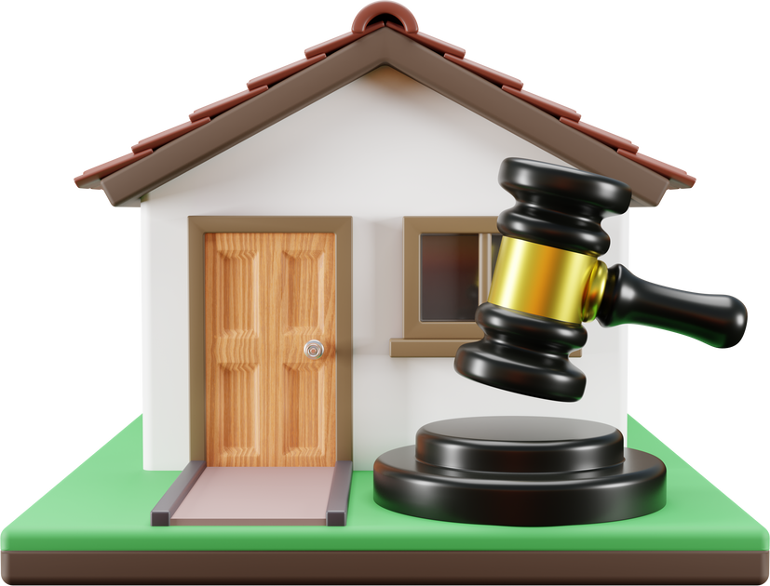
Developing an algorithm for risk analysis in deed documents.
B.Sc. (Hons) Degree in Information Technology Specializing in Information Technology
A.Thuvaraga ( IT22030412 )
IT22030412 | A.Thuvaraga | 25-26J-240
11/09/2025

Slide 13
Problem with Current Approaches
  Manual deed risk review → slow & costly
  Current AI legal tools → LLM-only pipelines
Expensive & hard to deploy
Poor accuracy for Sri Lankan legal domain
Existing System Comparision
V7 Go Agent | good at data extractionand risk generation , but no risk detection & no explainable alerts; not tailored to Sri Lankan law
DeedPlotter AI | trong at plotting land boundaries, but ignores legal correctness & clause verification; not Sri Lankan-specific
IT22030412 | A.Thuvaraga | 25-26J-240
11/09/2025

Slide 14
Research comparision
Researches | Limitations
Chakrabarti et al. (2019) – AI for Risk in Legal Documents | Relies on general NLP/ML methods (pre-LLM era). No agentic structure, lacks explainable outputs with evidence links. Limited adaptability to scanned/low-quality deeds.
ContractEval (2025) – Benchmarking LLMs for Clause-Level Risk | LLM-heavy → high compute cost, poor fit for low-resource settings. Focused on contracts, not specialized deed types (e.g., Power of Attorney, Gift). Does not integrate rule-based legal checks or OCR handling.
Belcak et al. (2025) – Small Language Models for Agentic AI | Conceptual/theoretical → doesn’t provide domain-specific implementation (like deeds). No evaluation on legal-specific datasets. Still requires integration with domain knowledge (rules) to be useful in practice.
IT22030412 | A.Thuvaraga | 25-26J-240
11/09/2025

Slide 15
Creative Solution
Warner & Spencer
  Hybrid pipeline: each deed routed to a specialized deed agent
  Inside agent:
Rule-based algorithm enforces mandatory checks across 8
deed types
Combines SLM + rules for nuanced risk detection
Advantages
  Affordable & deployable in low-resource contexts (vs. LLM-heavy tools)
  Tailored to Sri Lankan deed types (e.g., Power of Attorney, Gift Deed, Mortgage)
  Produces structured, evidence-linked risk reports with severity levels
  Works even on poor-quality scans with OCR confidence scoring
IT22030412 | A.Thuvaraga | 25-26J-240
11/09/2025

Slide 16
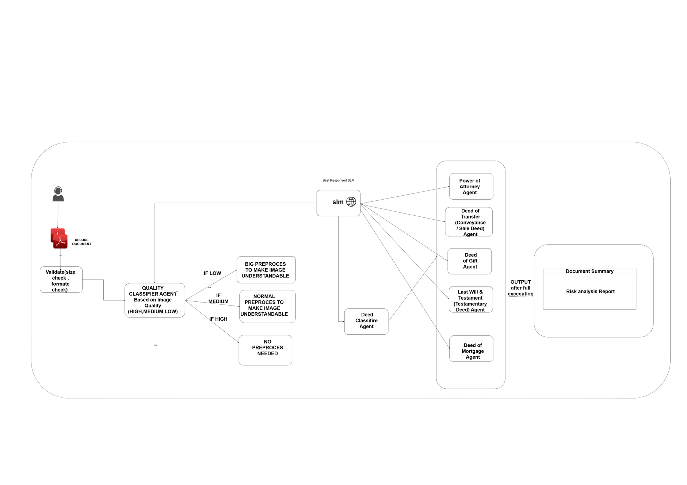
individual system overview daigram
Warner & Spencer
  Upload – User uploads a deed (PDF or scanned copy).
  Classify & Extract – System detects deed type and pulls key details.
  Risk Analysis – Rule checks + SLM prompts flag issues with severity levels.
  Review & Act – Reviewer sees evidence-linked alerts, verifies quickly, and takes informed decisions.
IT22030412 | A.Thuvaraga | 25-26J-240
11/09/2025

Slide 17
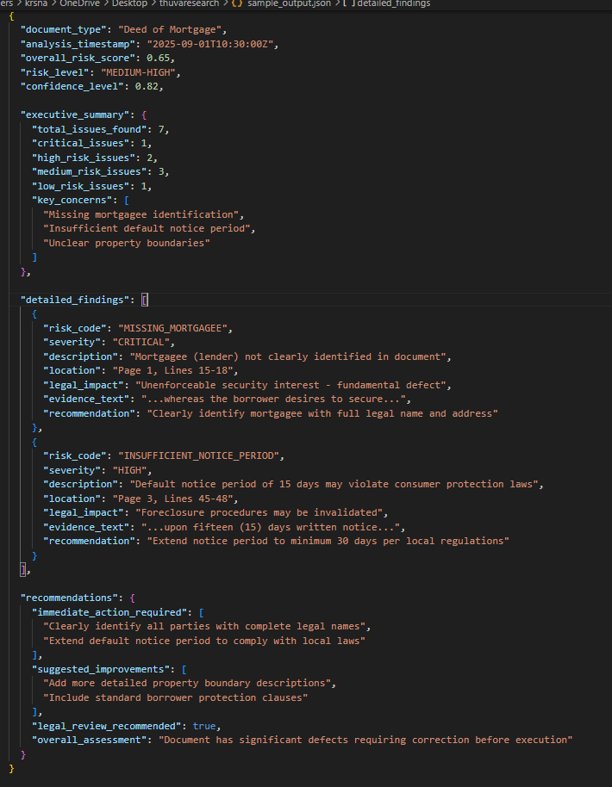
Sample Output
Warner & Spencer
IT22030412 | A.Thuvaraga | 25-26J-240
11/09/2025

Slide 18

Key Domains of Specialization & Technologies
Key Domains
•Agent Creation & Rule-Based Algorithms
•Natural language processing (NLP)
•Document Processing & OCR
•Risk Analysis & Retrieval
•Microservise Architechure
Technologies
•Small Language Models (SLMs)
•Postgrss sql
•Aws
•Fast Api
•Explainability Tools
•lang greaph , langchain
•Padel Ocr
•React
IT22030412 | A.Thuvaraga | 25-26J-240
11/09/2025

Slide 19
Application of Specialization-Based Knowledge
Warner & Spencer
Evaluation / Proving Success
  Validation Metrics:Accuracy and Validation will evaluate with industry experts and layers.
  Reviewer Feedback: Speed & trust in flagged evidence vs manual review.
Data Availability & Ethical Clearance
Data Availability
  Publicly accessible deed samples (registrar archives, legal practice material).
  Lawery give some sample deed documents deed risk detection books also.
•Ethical Clearance
  Only anonymized/public documents used for creating rule based algorithm.
  Designed to assist—not replace—legal professionals, reducing bias & risk of misuse.
IT22030412 | A.Thuvaraga | 25-26J-240
11/09/2025

Slide 20
References
Warner & Spencer
[1]D. Chakrabarti et al., “Use of Artificial Intelligence to Analyse Risk in Legal Documents for a Better Decision Support,” arXiv.org, 2019. https://arxiv.org/abs/1912.01111
[2]“ContractEval: Benchmarking LLMs for Clause-Level Legal Risk Identification in Commercial Contracts,” Arxiv.org, 2025. https://arxiv.org/html/2508.03080 (accessed Aug. 28, 2025).
[3]S. Wong, C. Zheng, X. Su, and Y. Tang, “Construction contract risk identification based on knowledge-augmented language model,” arXiv.org, 2023. https://arxiv.org/abs/2309.12626
[4]P. Belcak et al., “Small Language Models are the Future of Agentic AI,” arXiv.org, 2025. https://arxiv.org/abs/2506.02153
IT22030412 | A.Thuvaraga | 25-26J-240
11/09/2025

Slide 21
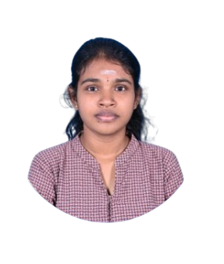
Law Recommendation system for users, specially focus on Employee and Labor law ​
​​
​​
​​
​​
B.Sc. (Hons) Degree in Information Technology Specializing in Information Technology
IT22322326 NIRUTHTHIKA E
IT22322326| Niruththika E | 25-26J-240
11/09/2025

Slide 22
Proven Gap/Creative Solution
Knowledge Gap
  People in Sri Lanka often struggle to act on legal problems, relying on individual lawyers who may not specialize in the relevant field, causing delays and inefficiency.
  The legal system is fragmented across acts, sections, and amendments, making it hard even for lawyers to identify the correct law, especially in labor and employment law.
Author(s) | Model | Shortcomings | Proposed Solution
S. M. W. Rahman, S. Kim, H. Choi, D. S. Bhatti, and H.-N. Lee (2024) | Legal Query RAG (Retrieval-Augmented Generation with recursive feedback) | RAG prone to hallucination, weak legal grounding, no adaptive refinement. | Uses ontology-guided RAG with SLM fine-tuning to cut hallucination and boost legal reliability.
Y. Zeng, X. Xiao, Z. Xu, and S. Liu (2025) | RoSiLC-RS (Robust Similar Legal Case Recommender System) | “Overfits to text similarity, weak embeddings, low robustness. | Uses contrastive learning with SLM-based embeddings and multi-vector RAG retrieval to improve case similarity and robustness.
IT22322326| Niruththika E | 25-26J-240
11/09/2025
11/09/2025
IT22322326 | Niruththika E | 25-26J-240

Slide 23
Shortcomings of Existing Systems and Solution
  Current reliance on manual searches, libraries, or simple keyword tools leads to incomplete or misleading results.
  Research proposes a fine-tuned small language model with Retrieval-Augmented Generation (RAG), trained on curated Sri Lankan labor and employment law documents, to deliver accurate, context-aware, scenario-based legal recommendations through a user-friendly interface for both lawyers and the public.
System | Infomration Accuracy | Technology
OpenAI | Relies on online/social media sources, risking misinformation. | Uses large LLMs—strong linguistically but not domain-specific, resource-heavy
AYNC | “Only basic references, no section–year–scenario mapping. | Minimal NLP, no transformers or RAG; acts as static glossary
Proposed solution | Trained on Sri Lankan labor law; outputs sections, years, and scenarios with high accuracy.” | Fine-tuned SLM with Agentic RAG, optimized for low-resource, high-accuracy use.
IT22322326| Niruththika E | 25-26J-240
11/09/2025

Slide 24
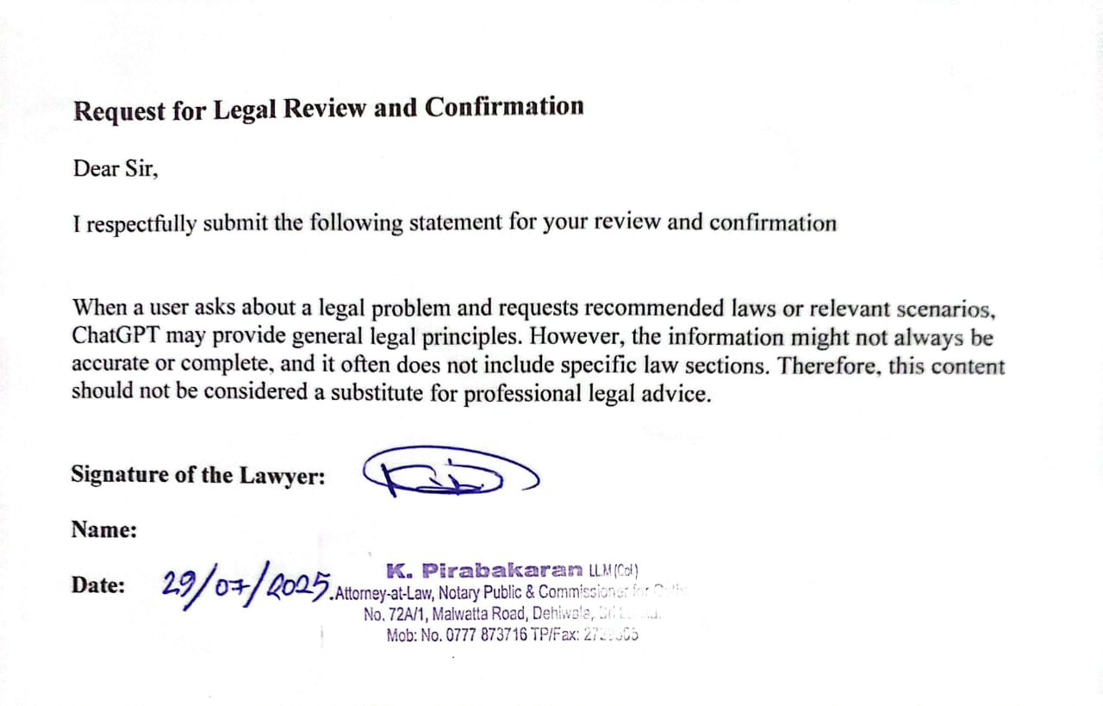

Business Company
IT22322326| Niruththika E| 25-26J-240
11/09/2025

Slide 25
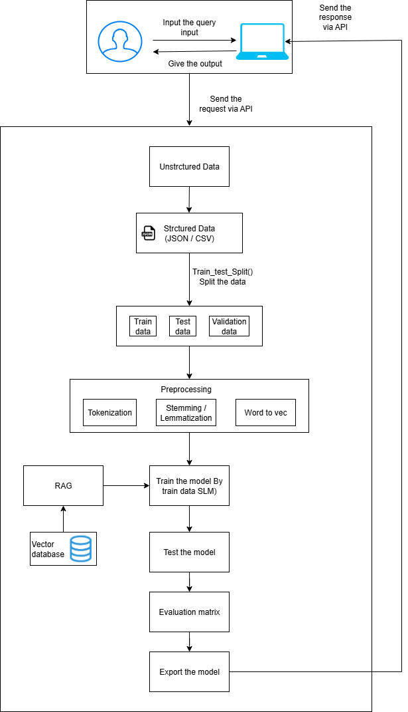
Individual System Diagram Overview and Real-World Example
User enters legal problem → The system analyzes the query → RAG and trained model search for the relevant law act name, year, and other scenarios. → The user receives the correct legal answer.
The user enters problem: “I worked for 1 year, but my employer terminated me without giving notice.” → The system analyzes the query → RAG and trained model search Termination of Employment of Workmen Act No. 45 of 1971, Section 2 and similar cases →The user receives the correct legal answer (Act No. 45 of 1971, Section 2, Year 1971, with other scenarios like “termination without notice” and “unfair dismissal”)
IT22322326| Niruththika E | 25-26J-240
11/09/2025

Slide 26
Domains of Knowledge
  Natural Language Processing: Apply tokenization, lemmatization, named entity recognition, and semantic embeddings to process user queries and map them to law sections.​
  Machine Learning: Fine-tune small language models on Sri Lankan labor law legal recommendations.
  Retrieval-Augmented Generation: Combine transformer outputs with FAISS-based retrieval for fact-grounded responses that reduce hallucinations and increase legal reliability.​
Latest Technologies Used
Text Processing Libraries ​
NLP & ML Models
Other Tools
NLTK, spaCy, Regex
DistilBERT, T5 base, Qwen2.5, GPT-2 small​
Git​
Draw.io​
AWS
​
Database
Similarity search
Frame work
Technology
MongoDB
FAISS
React.js​
FastAPI​
Unsloth​
PyTorch​
​
​
RAG
IT22322326| Niruththika E | 25-26J-240
11/09/2025

Slide 27
Evaluation / Success Metrics
  Validation: Expert/legal stakeholder surveys (average score ≥4/5), system latency under 5 seconds, and independent ethical compliance reviews.
  Refinement: Continuous feedback-based retraining to improve accuracy, reduce bias, and enhance usability.
Data Availability
Sources: Law Reports (SLR, NLR), Ministry of Justice, Supreme Court of Sri Lanka, Department of Government Printing, Legal books, scanned PDFs
Challenges: Non-digital, scattered, and noisy legal data requiring preprocessing, annotation, and structured metadata creation.
Ethical Clearance
  Privacy: Only publicly available legal PDF texts and verified data from lawyers are used.
  Transparency: The system makes clear that it only explains laws and gives guidance, not legal advice.
IT22322326| Niruththika E. | 25-26J-240
11/09/2025

Slide 28
REFERENCES
[1] A. Jayasooriya, A. Ahamed, Y. Bandara, C. Gavindya, D. Kasthurirathna, and L. Abeywardhana, “An innovative approach for legal information retrieval from Sri Lankan Supreme Court verdicts using NER and summarization models,” in Proc. 2023 5th Int. Conf. Advancements in Computing (ICAC), Colombo, Sri Lanka, Dec. 7–8, 2023, pp. xx–xx. doi: 10.1109/ICAC60630.2023.10417286.​
​
[2] S. M. W. Rahman, S. Kim, H. Choi, D. S. Bhatti, and H.-N. Lee, “Legal Query RAG: Enhancing legal recommendation with retrieval-augmented generation and recursive feedback,” IEEE Access, vol. 12, pp. 115631–115645, 2024. DOI: 10.1109/ACCESS.2024.3456789.
​
[3] Y. Zeng, X. Xiao, Z. Xu, and S. Liu, “RoSiLC-RS: A robust similar legal case recommender system,” Neurocomputing, vol. 616, pp. 127–137, 2025. doi: 10.1016/j.neucom.2025.126983.
IT22322326| Niruththika E. | 25-26J-240
11/09/2025

Slide 29

Predicts likely legal judgments by analyzing past case
for Criminal Law ​
​​
​​
​​
​​
B.Sc. (Hons) Degree in Information Technology Specializing in Information Technology
Abiramy.T ( IT22049322 )
IT22049322| Abiramy T | 25-26J-240
11/09/2025

Slide 30
Knowledge Gap
  Inefficiencies in justice: Delays, limited digitization, backlogs, high costs, unequal access for Penal Code crimes (theft, assault, homicide).
  Lack of localized AI: Resource-heavy LLMs ignore Sri Lanka's hybrid laws, multilingual needs, biases.
Research gap of Existing Systems
Author(s) | Model | Gap | Proposed Solution
Aralimatti et al. | Shakti SLM (100M-500M) | High resource demands, lacks Sri Lankan legal focus, limited edge AI | Uses optimized SLMs with quantization for edge use, localized data
Jayasinghe et al. | RoBERTa (U.S. Supreme Court) | U.S.-centric, 75.75% accuracy, no hybrid legal adaptation | Tailored for Sri Lanka’s hybrid system, multilingual support
IT22049322| Abiramy T | 25-26J-240
11/09/2025

Slide 31
Key Domains Utilized
  NLP/AI: Text vectorization and prediction for legal contexts.
  Legal/Edge AI: Adaptation to hybrid systems, efficient deployments.
  IT Specialization: Scalable app architectures
Specific Latest Technologies
  BERT: Vectorizes legal texts for context.
  FAISS: Vector database for fast searches on edge devices.
  OpenAI API: Summarizes precedents into clear outputs.
  React.js/Next.js: Frontend chat interface with Tailwind CSS.
  FastAPI: Backend for API handling.
IT22049322| Abiramy T | 25-26J-240
11/09/2025

Slide 32
Evaluation
  Metrics: Precision/Recall >75%, ROUGE/BLEU >0.5, F1 >70%; bias audits.
  Validation: Stakeholder surveys (score ≥4/5), latency <5s; ethical reviews.
  Refinement: Feedback-based retraining.
Data Availability and Ethical Clearance
  Sources: Public Sri Lanka Law Reports, Supreme Court judgments, Ministry of Justice archives (500-1000 anonymized cases).
  Anonymized data, permissions from SLIIT, compliance with Sri Lanka's Data Protection Act; bias mitigation via diverse sampling; on-device processing for privacy.
IT22049322| Abiramy T | 25-26J-240
11/09/2025

Slide 33
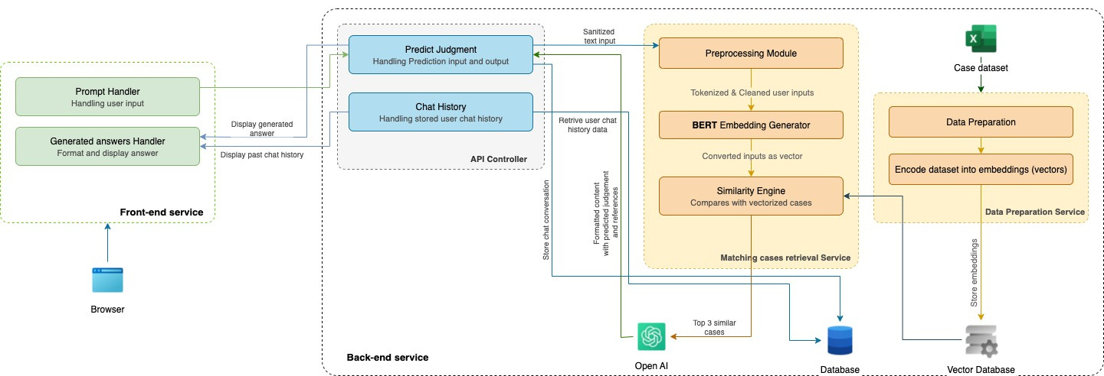
System Overview
IT22049322| Abiramy T | 25-26J-240
11/09/2025

Slide 34
Real-World Use case
Scenario: A lawyer or citizen inputs case details (e.g., crime type, facts, provisions) via the chat interface on a smartphone or computer. The app retrieves relevant precedents (e.g., theft cases under Penal Code), predicts outcomes (e.g., acquittal probability), and provides summarized reasoning.
Benefits: Reduces research time from hours to seconds, aids in plea bargaining or public awareness; deployable in courts, legal aid centers, or personal devices without internet dependency; users provide feedback for improvements, ensuring equitable access in resource-constrained areas like rural Sri Lanka.
IT22049322| Abiramy T | 25-26J-240
11/09/2025

Slide 35
References
[1] A. Babu and S. B. Boddu, “BERT-Based Medical Chatbot: Enhancing Healthcare Communication through Natural Language Understanding,” Exploratory Research in Clinical and Social Pharmacy, vol. 13, p. 100419, Mar. 2024, doi: 10.1016/j.rcsop.2024.100419.
[2] C. M. Greco and A. Tagarelli, “Bringing order into the realm of Transformer-based language models for artificial intelligence and law,” Artif Intell Law, vol. 32, no. 4, pp. 863–1010, Dec. 2024, doi: 10.1007/s10506-023-09374-7.
[3] M. J. Davenport, “Enhancing Legal Document Analysis with Large Language Models: A Structured Approach to Accuracy, Context Preservation, and Risk Mitigation,” OJML, vol. 15, no. 02, pp. 232–280, 2025, doi: 10.4236/ojml.2025.152016.
[4] M. Siino, M. Falco, D. Croce, and P. Rosso, “Exploring LLMs Applications in Law: A Literature Review on Current Legal NLP Approaches,” IEEE Access, vol. 13, pp. 18253–18276, 2025, doi: 10.1109/ACCESS.2025.3533217.
IT22049322| Abiramy T | 25-26J-240
11/09/2025

Slide 36
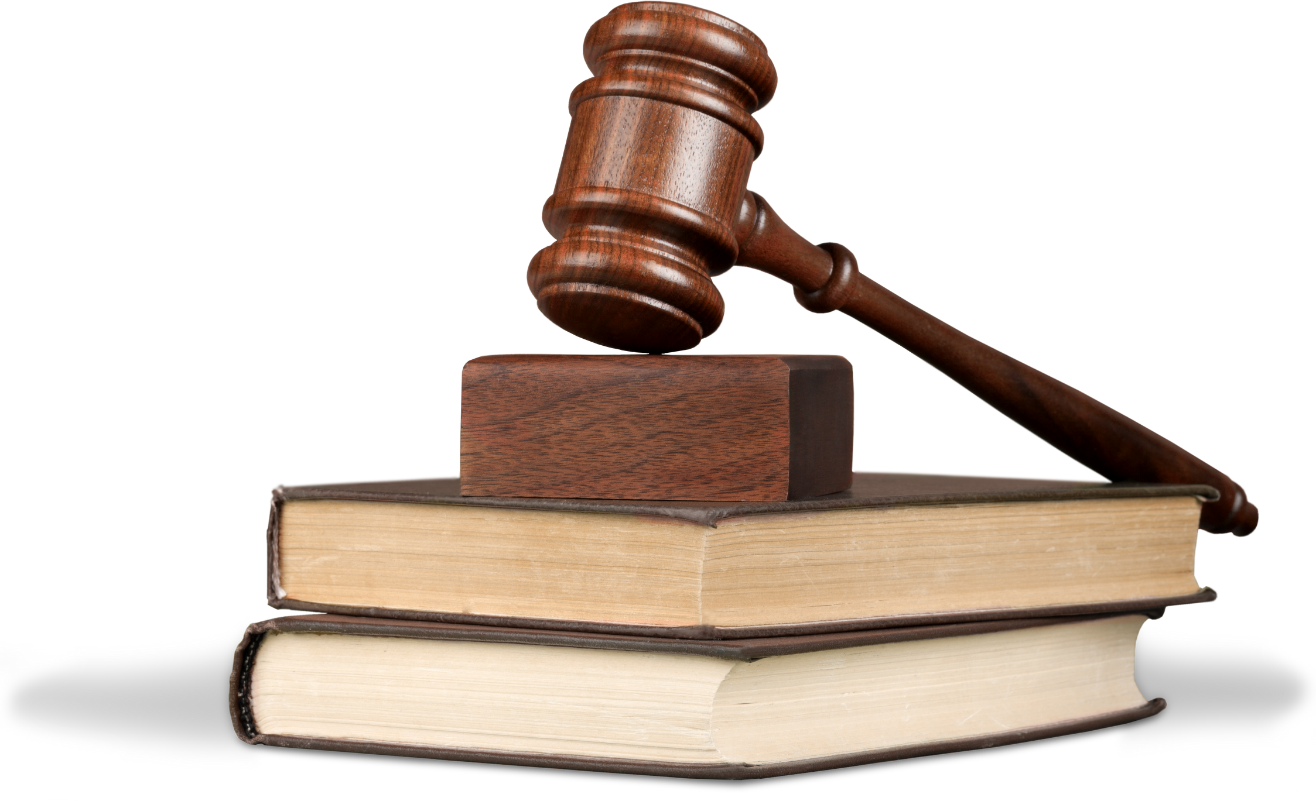
Thank You Any Question?
25-26J-240
11/09/2025

